Slide 1
0x302 – Reading Out Firmware
ECED4406 – Computer Security
Dr. Colin O’Flynn
Dalhousie University.

Slide 2
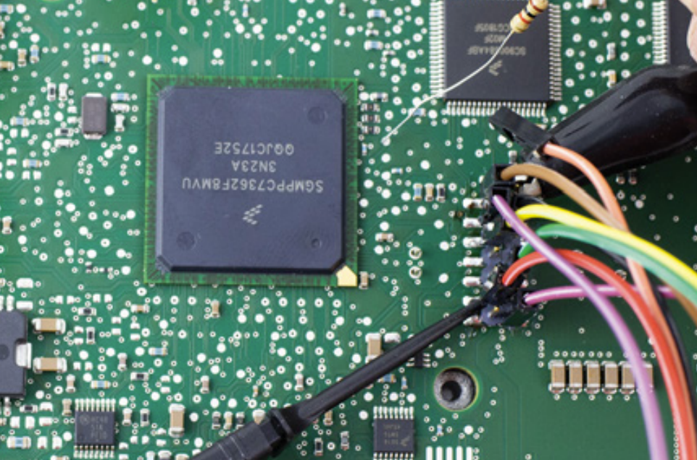
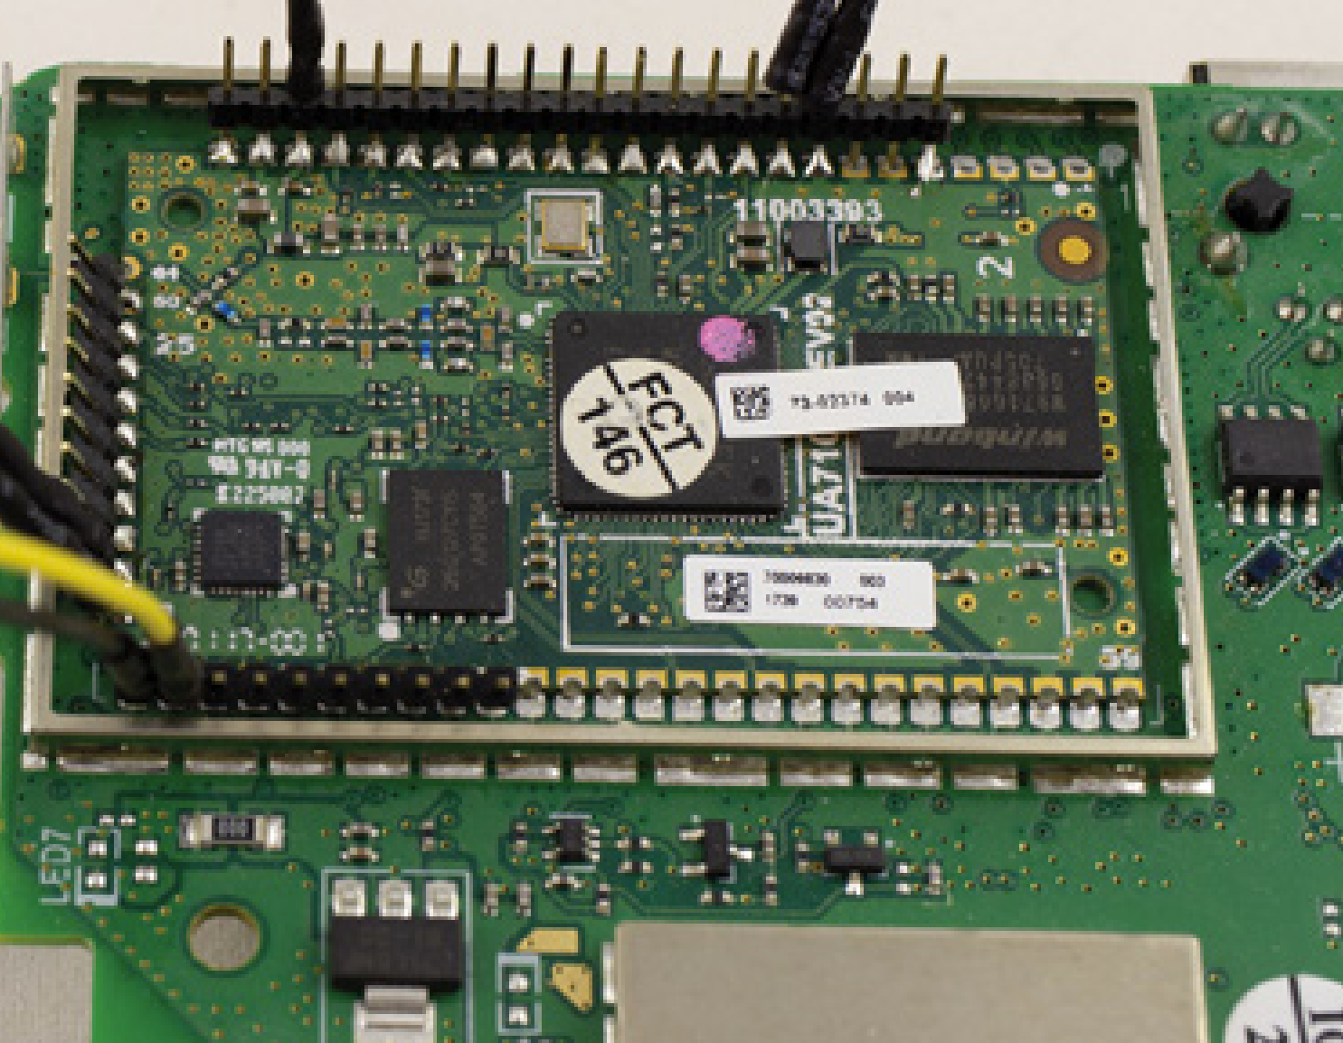
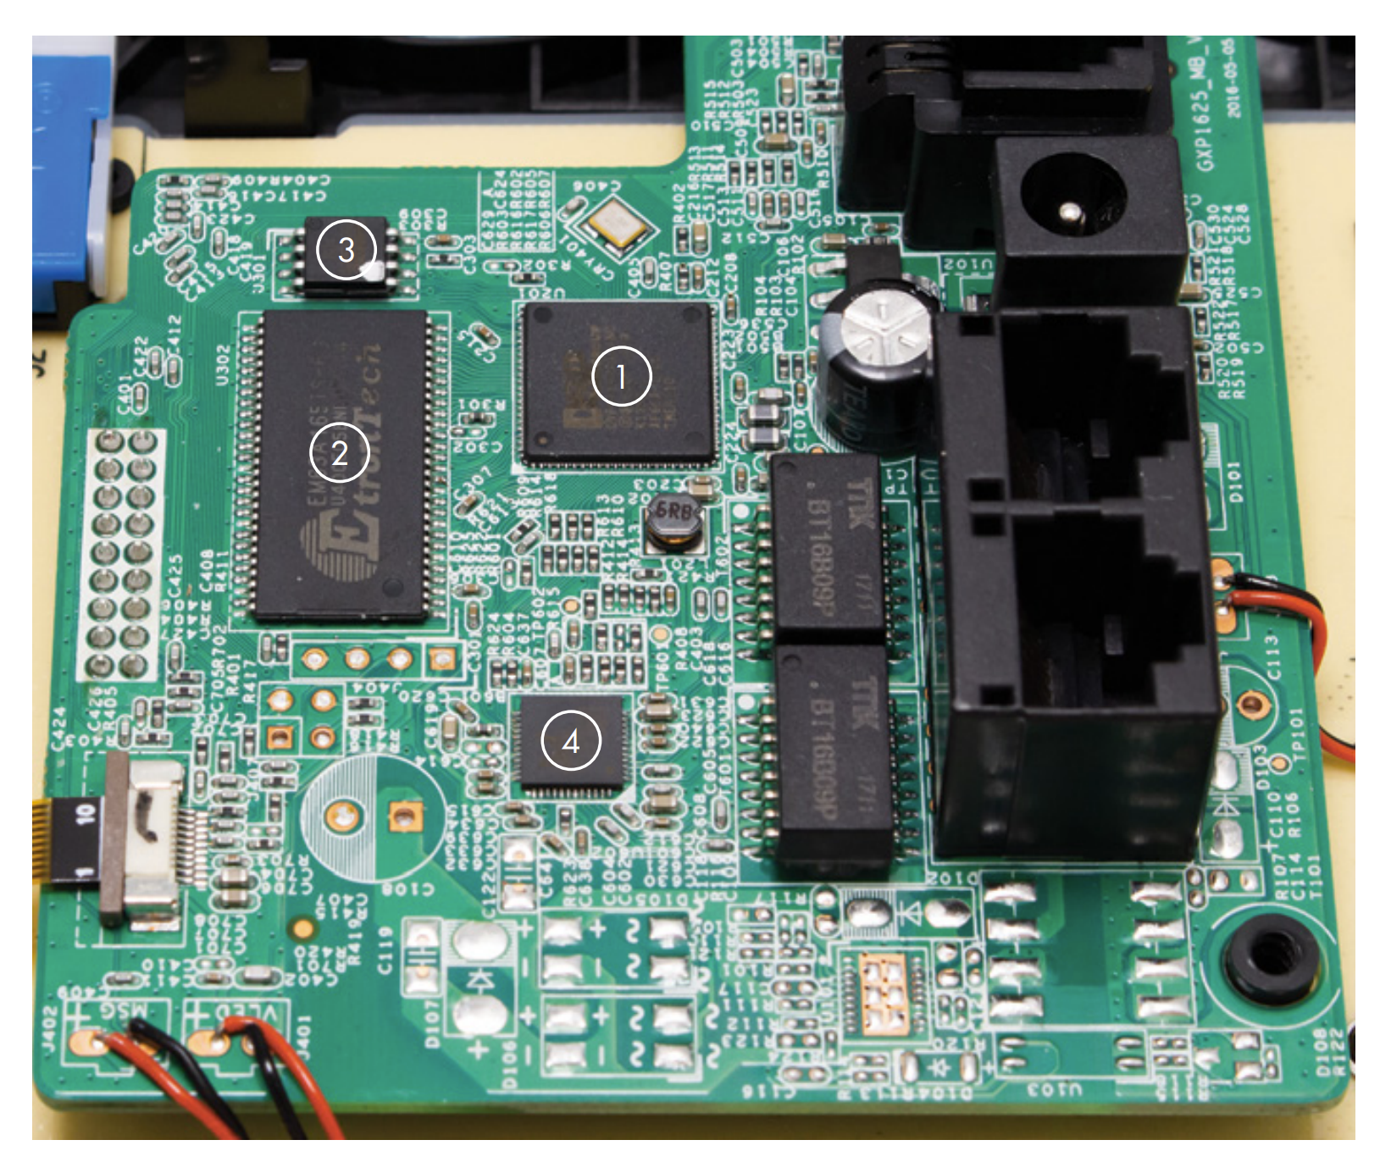
Finding Firmware

Slide 3
Firmware Locations on Board
Initial view: Firmware is either:
Programmed into “internal” memory.
-> E.g., like Arduino and other devices you may have used where the microcontroller contains the code.
Programmed into “external” memory.
-> E.g., like Raspberry Pi where the microSD card contains the firmware.

Slide 4
Typical Boot Process
Linux Bootloader
MicroSD card or eMMC (large Flash)
Processor Core
First Stage Bootloader
Boot ROM
Main “SoC” Chip
Small flash chip

Slide 5
Where to Look for Firmware?
Firmware may be included in multiple locations on the board.
You may need to “read” all of the devices to understand the true boot process.

Slide 6
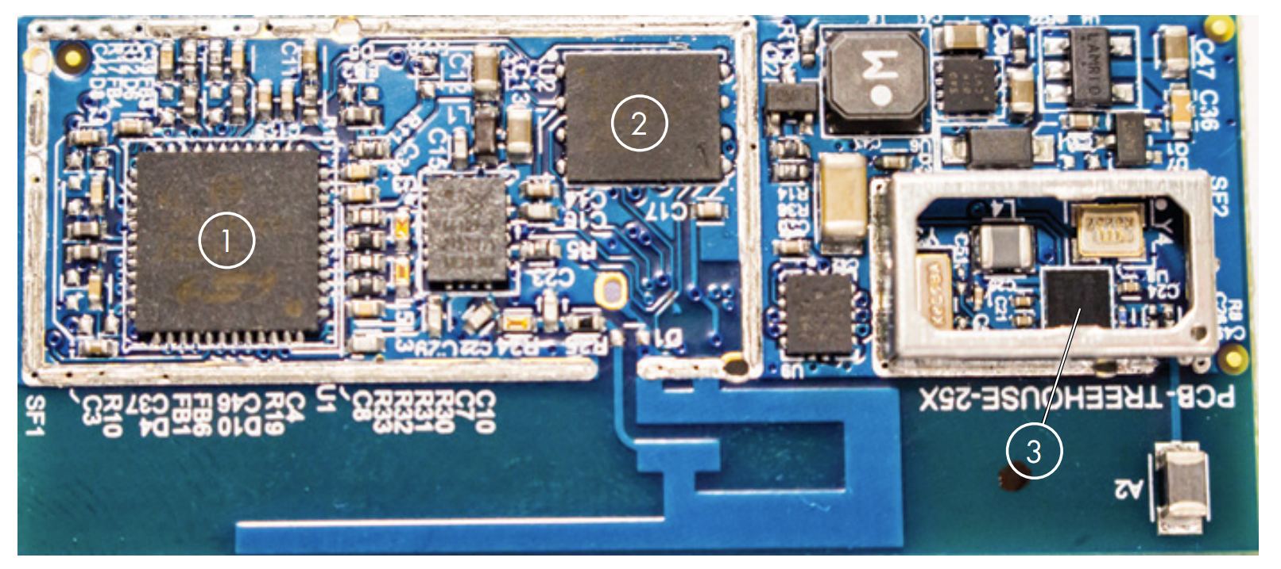
Internal Flash Read-Out
Devices may have internal flash. These devices will typically require some sort of programmer to read. This may be device-specific. It is often disabled.
1. This microcontroller in a smart lock requires a specific programmer.

Slide 7
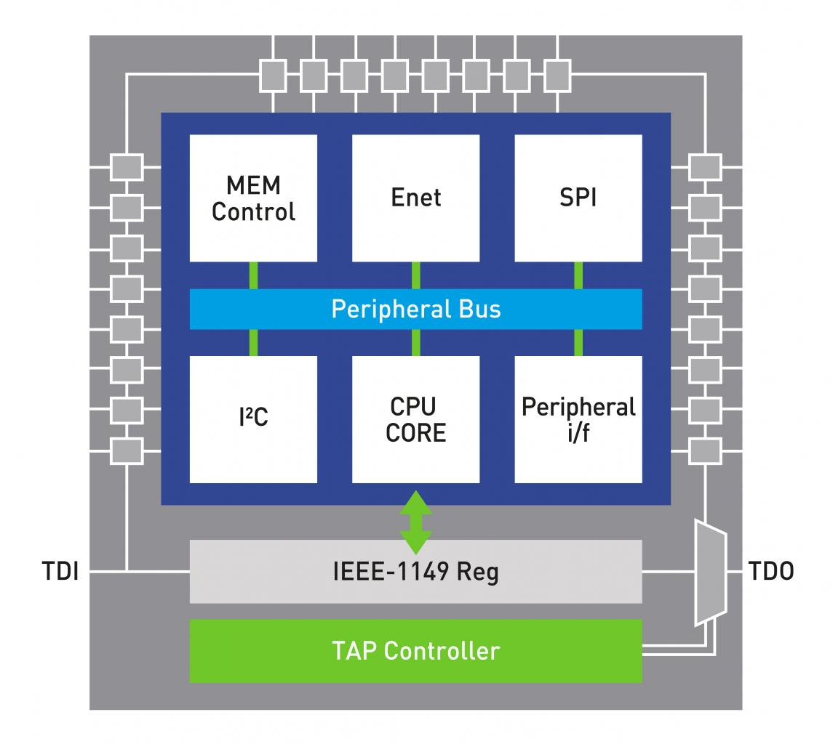
“JTAG” Port
JTAG = Joint Test Action Group
JTAG in “Boundary Scan” Mode has access to all I/O pins.
TDI = Test Data In
TCLK = Test Clock
TMS = Test Mode Select
TDO = Test Data Out

Slide 8
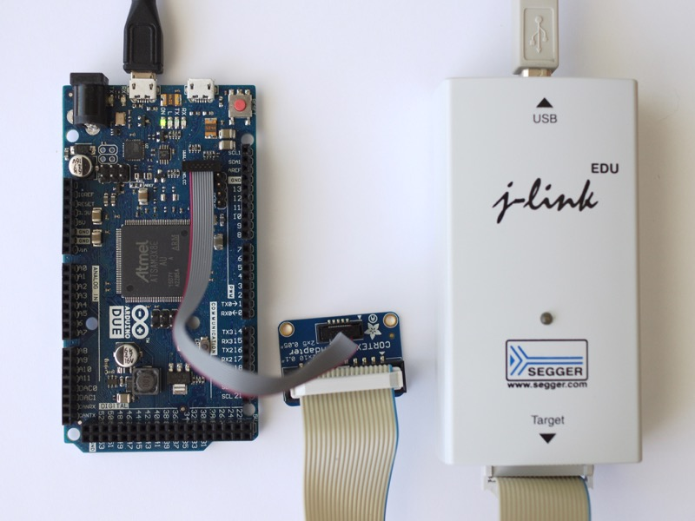
JTAG as a Debugger

Slide 9
JTAG as a Debugger
Normally some sort of software gives us “Debug Access”
Maybe allows read/writing of memory
Maybe allows single-stepping and similar
Often devices will “lock out” debug or JTAG for security
All devices should do this in production for security, but sometimes they don’t

Slide 10
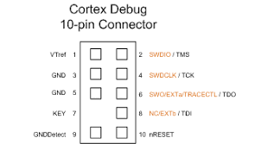
Cortex-M “SWD” Pins
“Serial Wire Debug” is a protocol that effectively reduces the JTAG pins to only needed 2 pins:
Serial Wire Debug Input Output (SWDIO)
Serial Wire Debug Clock (SWCLK)
On smaller Arm Cortex-M devices this is very common. You’ll often not see the full-size JTAG header or test points, and only find these two test points.
Normally it also has nRESET (NRST) and sometimes “Serial Wire Output” (SWO), a special additional debug out.

Slide 11
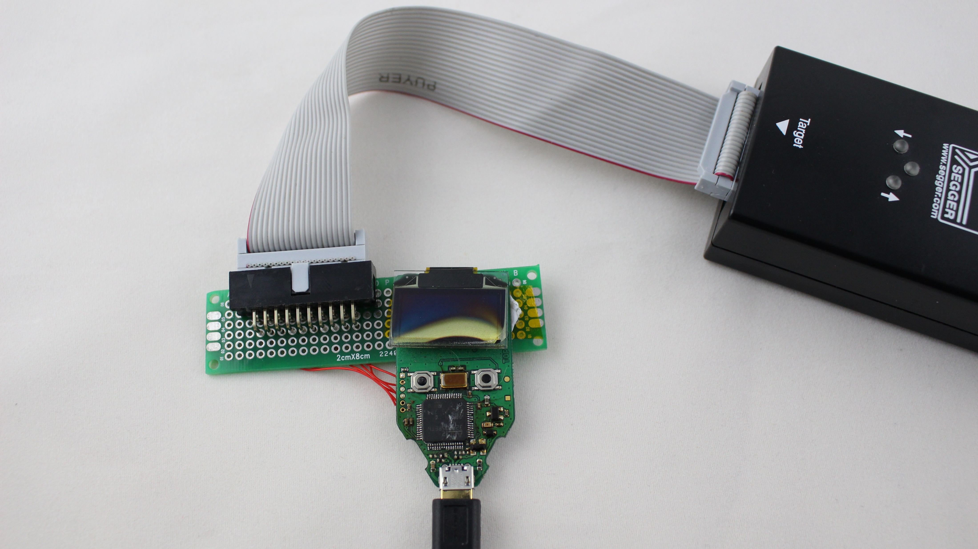
Typical Embedded (Arm) Read-Out Attempts
JTAG Tool (Segger J-Link)
Adapter to SWD Pins
Target

Slide 12
SPI Flash Chip Read-out
Example of a SPI flash chip (2) (often looks like this or the SOIC-8 below, ‘3’)

Slide 13
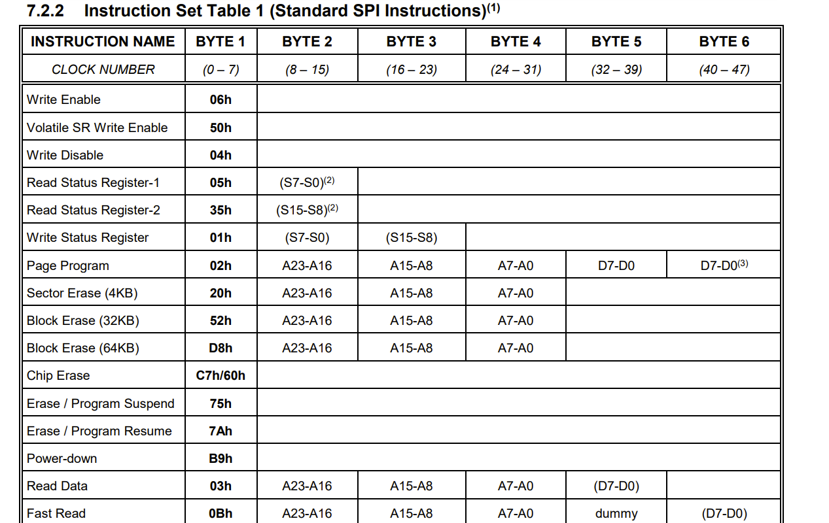
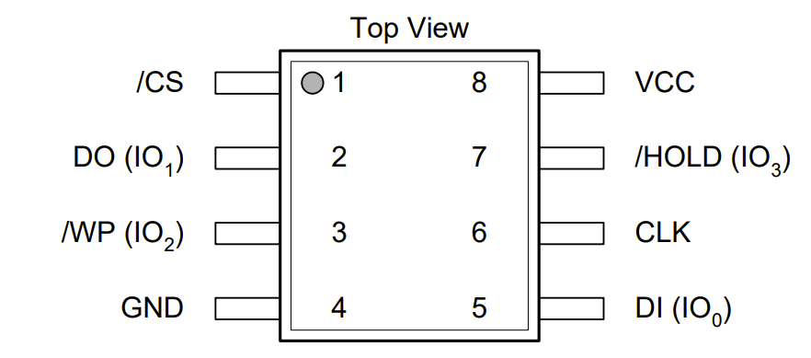
SPI Flash Chip
Typical SPI flash pinout
(Can vary – check your device)
This example is from W25Q64FV

Slide 14
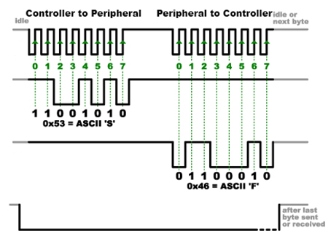
SPI = Serial Peripheral Interface
SPI has a controller (historically may be called the master) that drives communication. It talks to the slave (peripheral) device.
Controller
SCK
Peripheral
COPI
CIPO
CS
Clock (SCK/SCLK)
Clock is driven from controller.
Data FROM controller (COPI/MOSI)
Controller Out Peripheral In
Data FROM peripheral (CIPO/MISO)
Controller In Peripheral Out
Chip Select (CS/SS)
Enable pin driven from controller to the specific peripheral.

Slide 15
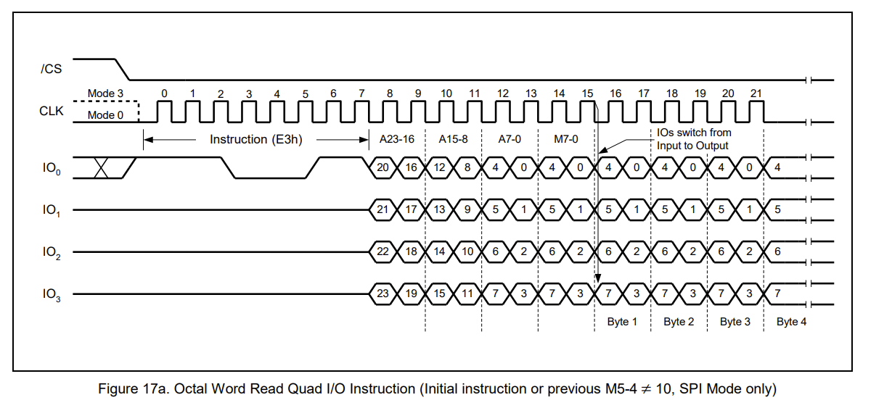
DSPI / QSPI = Dual/Quad SPI
Devices may support a higher-data-rate mode.
These devices always support the basic commands, and then allow a “switch” to faster modes.
For our work we don’t (normally) use those modes, but if you are sniffing the protocol will need to understand them.

Slide 16
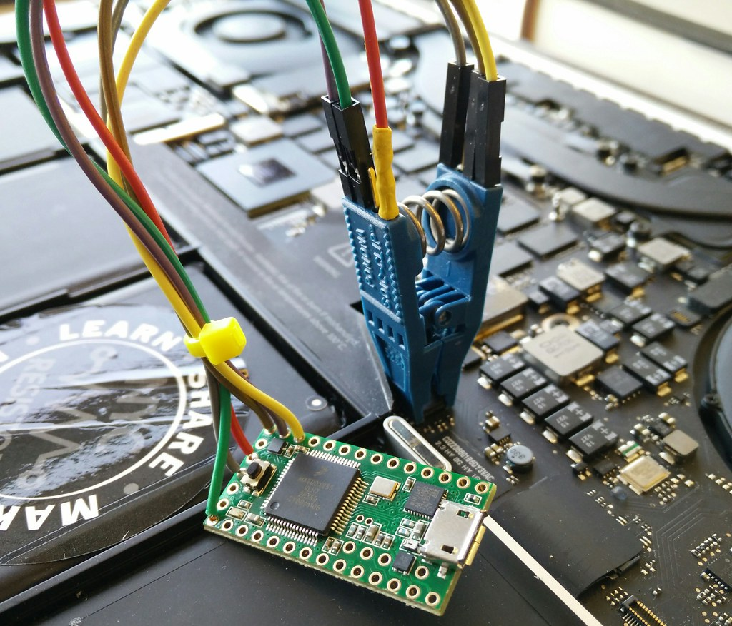
Reading out SPI Flash Devices
Various tools you can use include:
Bus Pirate with Flashrom
Many tutorials online, such as https://ivanorsolic.github.io/post/hardwarehacking1/
Tigard with Flashrom
https://github.com/tigard-tools/tigard#spi
Raspberry Pi with Flashrom
https://nsideattacklogic-tech.blogspot.com/2018/06/dumping-spi-flash-memory-of-embedded.html
Trammell Hudson’s tool (see link at left)
…also many others!
From Trammell Hudson: https://trmm.net/SPI_flash/

Slide 17
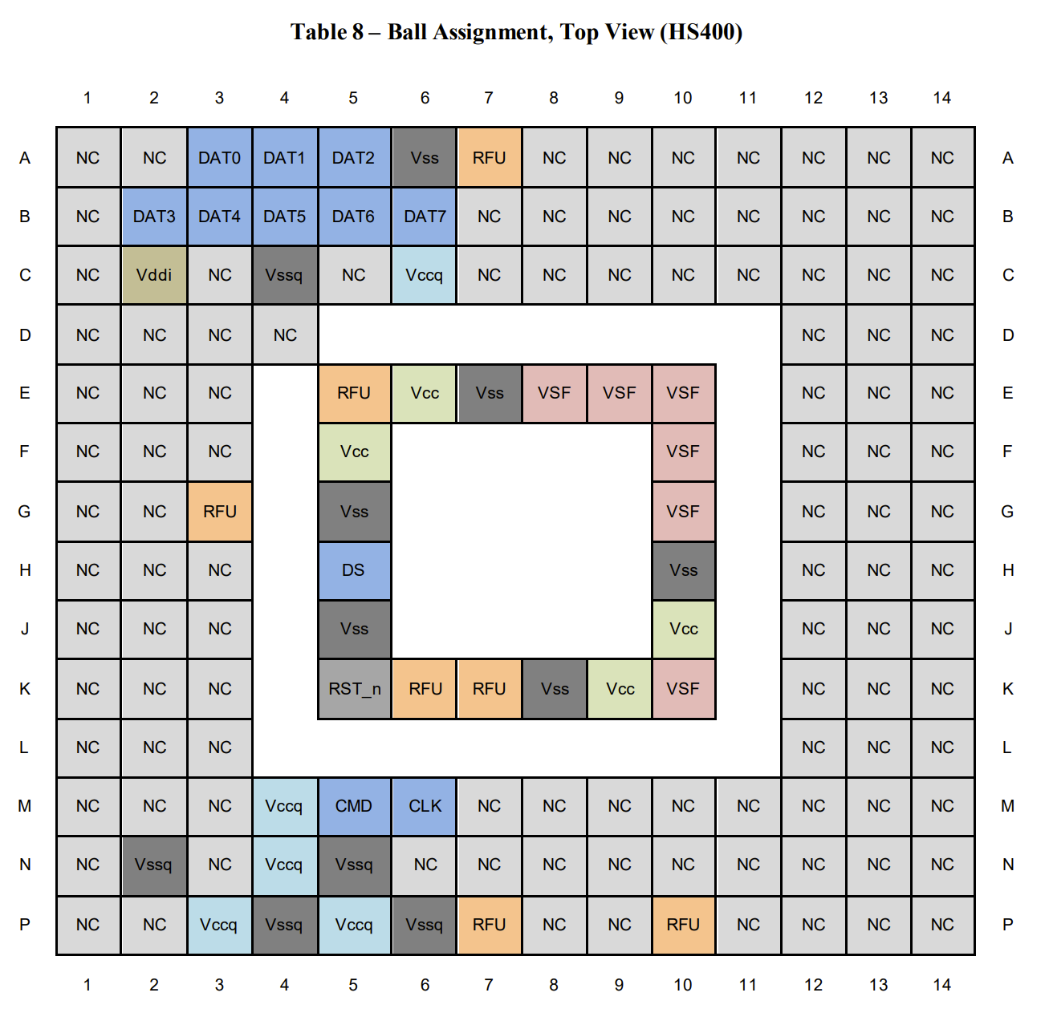
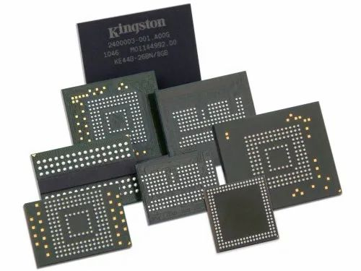
eMMC Flash Chip vs SPI Chip
Embedded Multi-Media Card
e.g., EMMC04G-W627

Slide 18
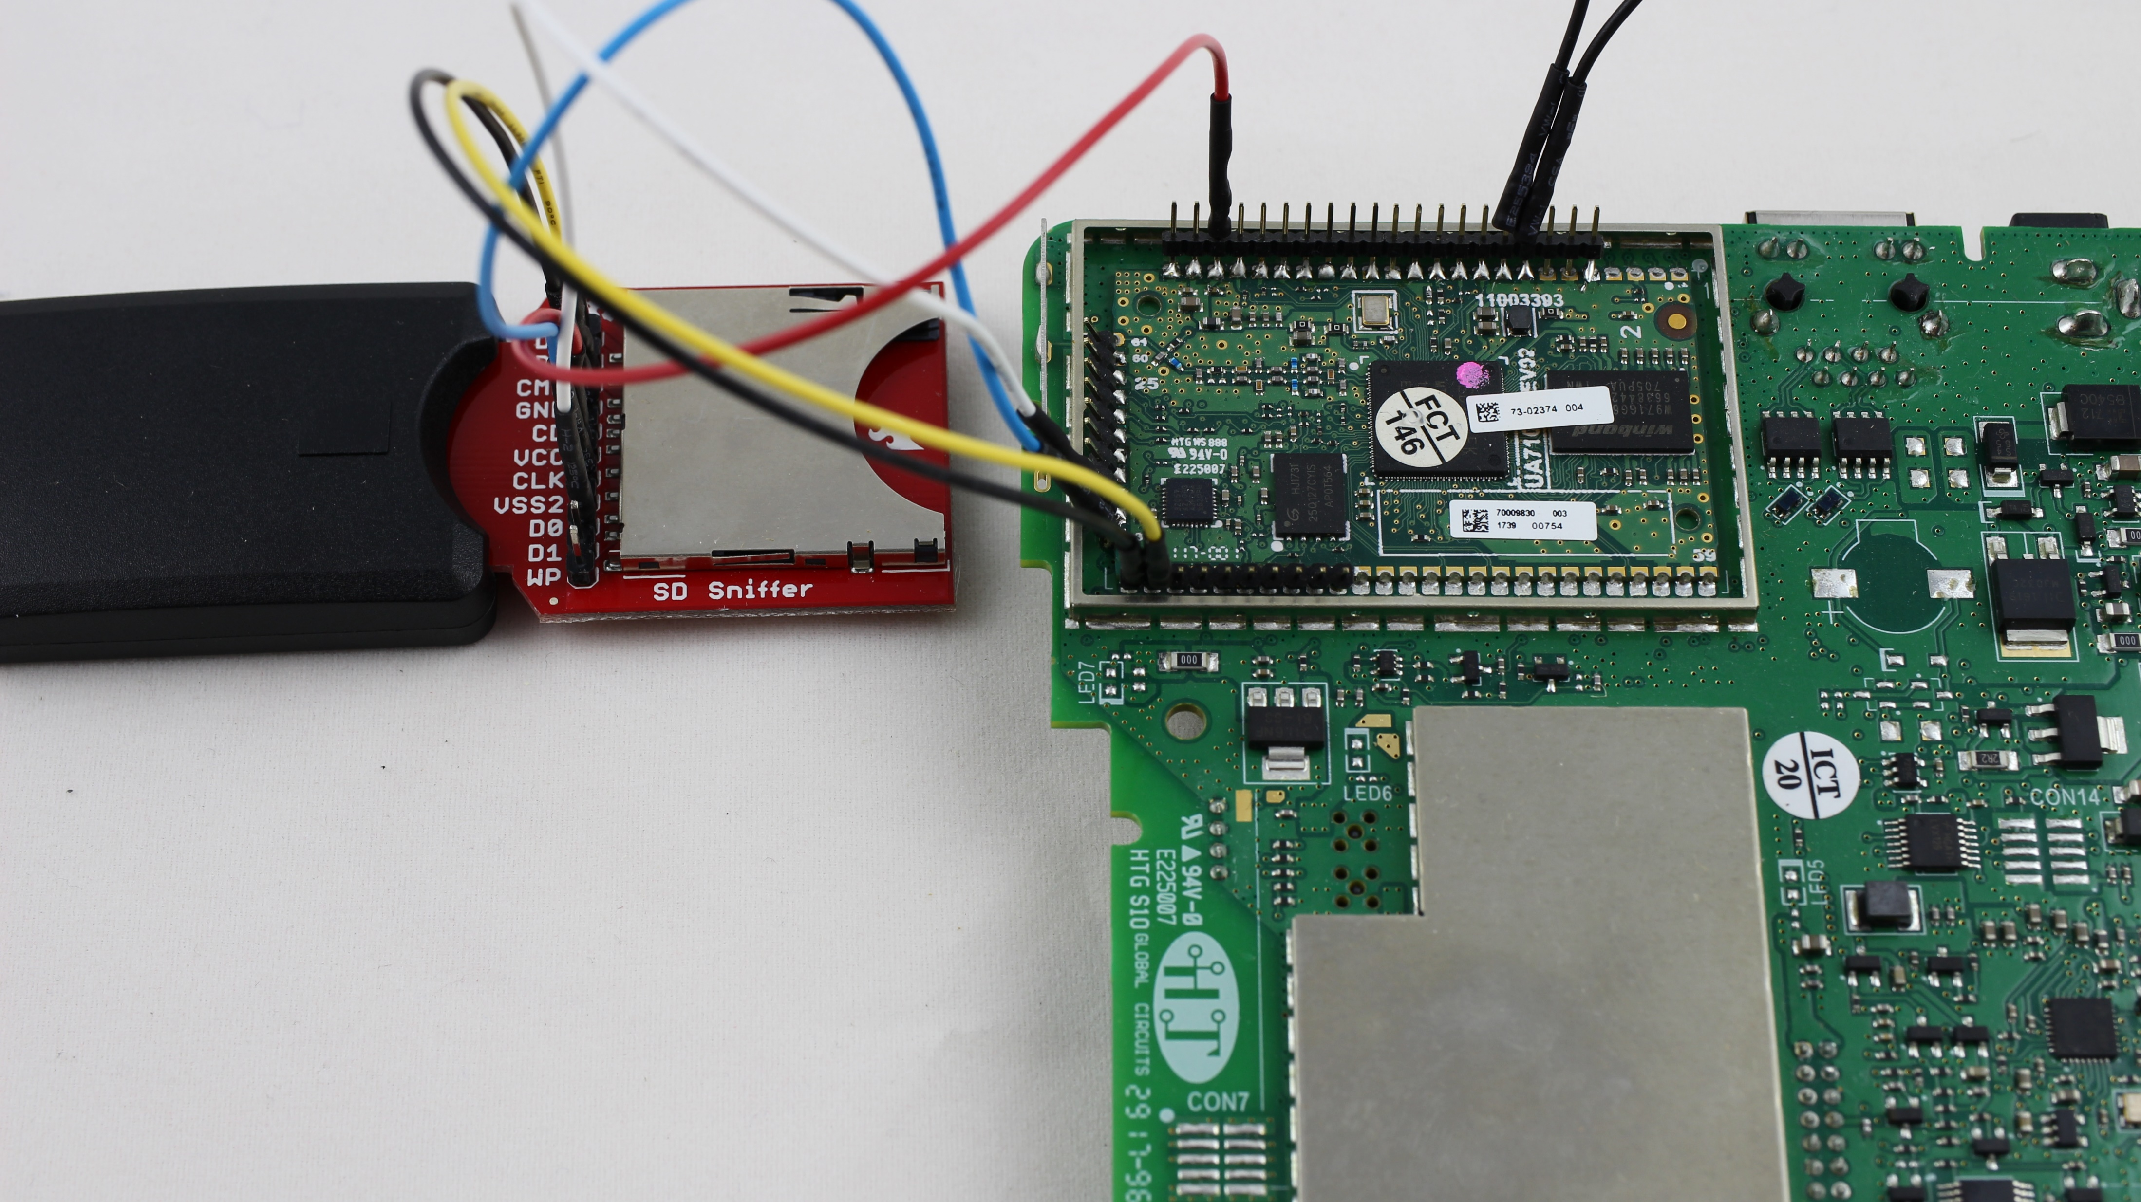
eMMC Read-Out via SD Card Carrier

Slide 19
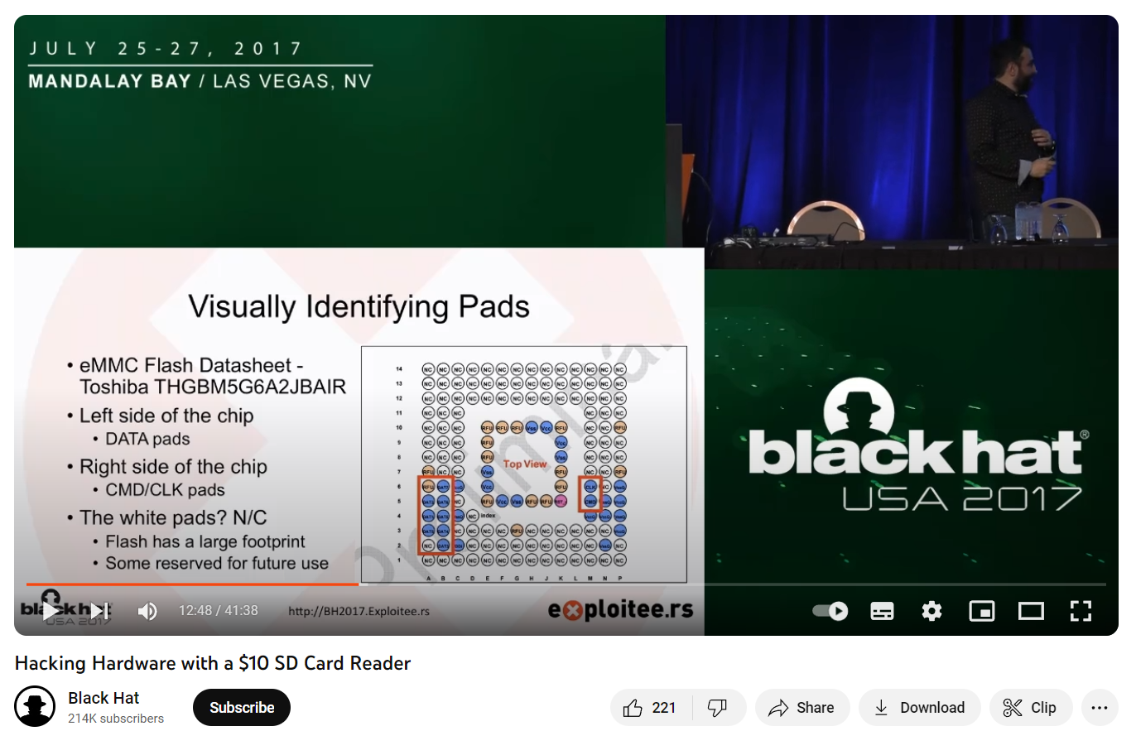
eMMC / SD Card Links
https://www.youtube.com/watch?v=6ofPbclXuZQ
https://www.blackhat.com/docs/us-17/wednesday/us-17-Etemadieh-Hacking-Hardware-With-A-$10-SD-Card-Reader.pdf

Slide 20
Firmware Read Out – Next Steps
With firmware read out – do some basic sanity checks as discussed in previous lecture (binwalk, strings, etc).
Then we can go ahead with reverse engineering steps.

